Slide 1
Software Engineering and Architecture
Networking in Java:
Sockets

Slide 2
Networking from Code
The most fundamental abstraction of network is the Socket
So, your computer has an IP address, and you then create a Socket with a specific port number
And you have something you can address from a client

Slide 3
The Socket Abstraction
Once a socket is established you can get an input- and output stream
That is, you can read and write to the stream, just as you would read and write to a File!

Slide 4
Example from Java Tutorial
The Echo Server
Just returns anything you send to it (Booooring...)
Start the server on port 37000
And a client
Notes:
META: In FRSProject/echo

Slide 5
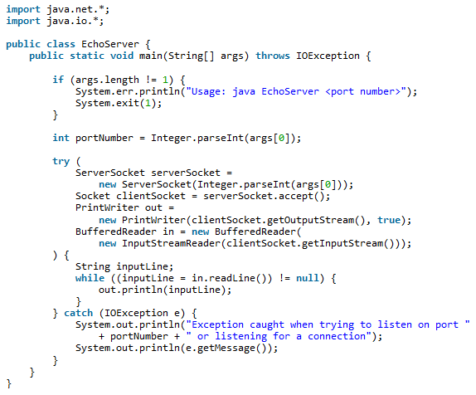
Echo
Echo Server

Slide 6
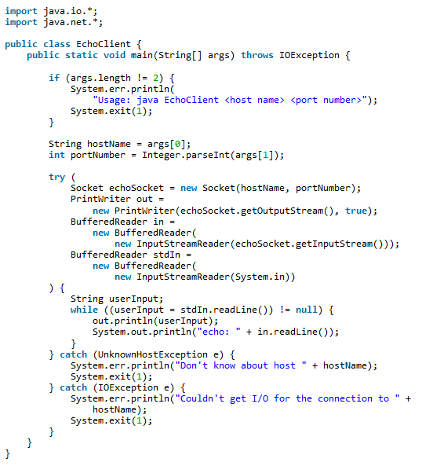
Echo
Echo Client
Note the asymmetry
Client: ‘Socket’
Server: ‘ServerSocket’

Slide 7
Exercise
Now, you have enough to build Fortnite or LoL ☺
Tack a bit of graphics on...
Almost...
Quality Attributes needed
Security
Performance
Availability
Modifiability – the programming model is terrible lowlevel
The reason we will do Broker
Architectural Pattern to address the programming model…

